Slide 1

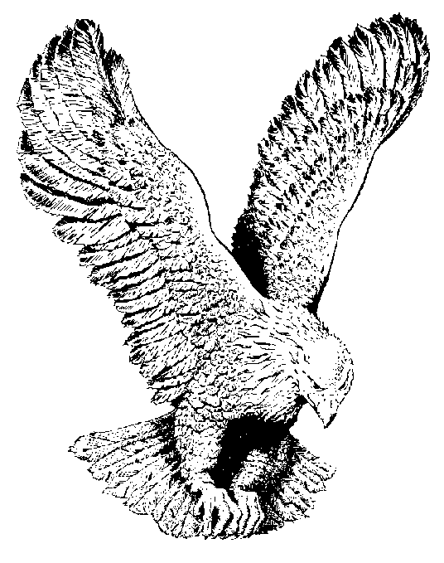
167
THE OLD RUGGED CROSS
On a hill far away stood an old rugged cross,
The emblem of suffering and shame,
And I love that old cross where the Dearest and Best,
For a world of lost sinners was slain.

Slide 2
CHORUS
So I’ll cherish the old rugged cross,
Till my trophies at last I lay down;
I will cling to the old rugged cross,
And exchange it some day for a crown.

Slide 3
Oh, that old rugged cross, so despised by the world,
Has a wondrous attraction for me;
For the dear Lamb of God left His glory above,
To bear it to dark Calvary.

Slide 4
In the old rugged cross, stained with blood so divine,
A wondrous beauty I see.
For ‘twas on that old cross Jesus suffered and died,
To pardon and sanctify me.

Slide 5
To the old rugged cross I will ever be true,
Its shame and reproach gladly bear;
Then He’ll call me some day to my home far away,
Where His glory forever I’ll share.

